Slide 1
E-SPORTS
DATA
Group 5
Alice, Justin, Bryan, Brandon

Slide 2
01
Scenario

Slide 3


YOU

Slide 4
YOUR FRIEND
YOU

Slide 5
YOUR FRIEND
YOU
Hardstuck silver

Slide 6
YOUR FRIEND
YOU
-Crazy reaction time and APM
-Grandmaster+ in every game he touches
-hates his 9-5
-touches grass once in a blue moon
Hardstuck silver

Slide 7

Logically…
He decides to go pro!
But what are his best odds? (given that he can move anywhere and pick up any game)

Slide 8

02
Total Earnings
Since 1998

Slide 9

II. EARNINGS
Which game has the most earnings?

Slide 10
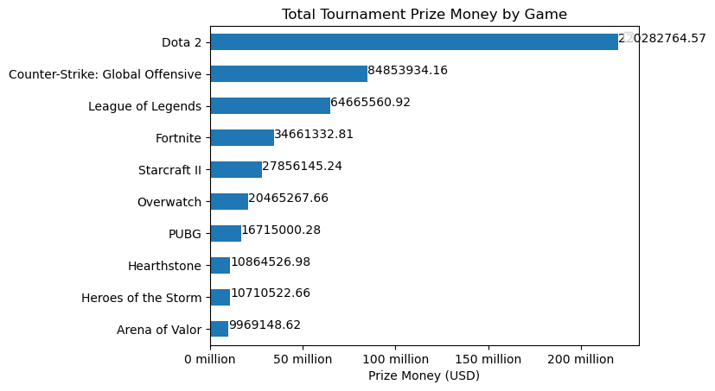

Slide 11
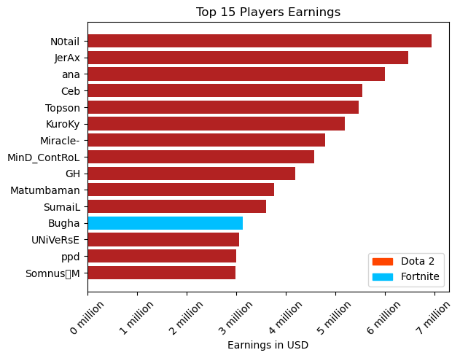

Slide 12

Visually, Dota2 dominates, so let’s confirm using an ANOVA test…
H₀: There is no difference in mean prize earnings.
H_{A}: There is a difference in mean prize earnings.
F_{stat} = 133.62 p-value = 7.12E-19
Since the p-value is less than 0.05, we reject the null hypothesis because there is sufficient evidence to accept that there is a difference in mean prize earnings.

Slide 13
II. EARNINGS
We’ve confirmed that Dota2 dominates, so let’s compared earnings by game.

Slide 14
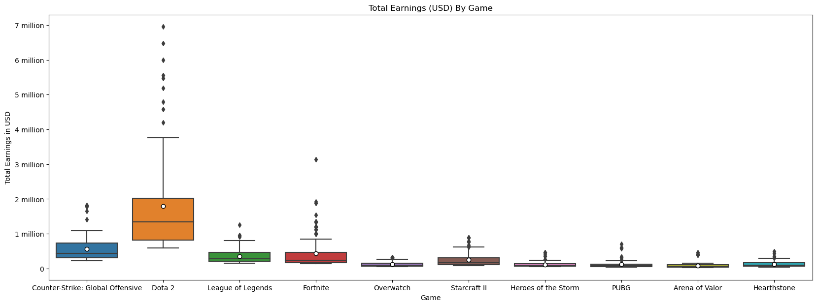
While Dota 2 still dominates, you still have good odds with CS:GO, League of Legends, Fortnite, and Starcraft.

Slide 15
II. EARNINGS
Which countries have the most
esports earnings?

Slide 16
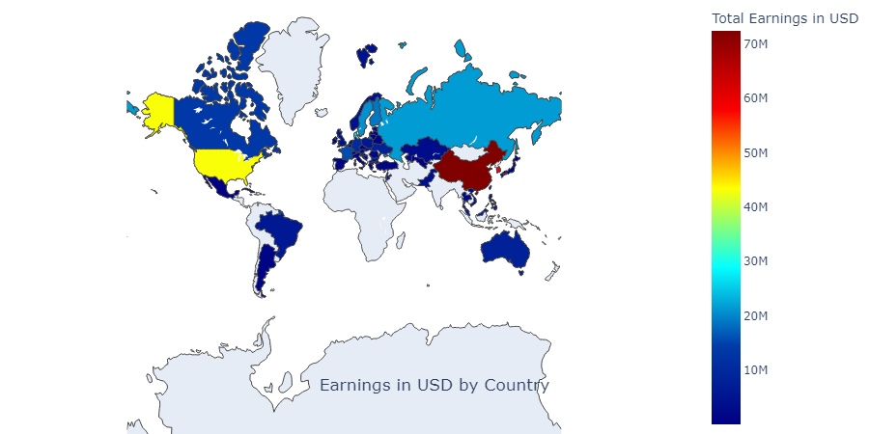
Seems like China and Korea are doing really well. To see if the difference in means is significant, we ran a z-test.

Slide 17

Is China/Korea really better than the rest?
H₀: There is no difference in mean prize earnings between CN and the rest of the world.
H_{A}: There is a significant difference in mean prize earnings between CN and the rest of the world.
Z- score: 0.58 p- value = 0.559
Since the p-value is greater than 0.05, we fail to reject the null hypothesis since there is not enough evidence to conclude the alternate hypothesis.
H₀: There is no difference in mean prize earnings between KR and the rest of the world.
H_{A}: There is a significant difference in mean prize earnings between KR and the rest of the world.
Z-score: 3.74 p-value = 0.00018
Since the p-value is less than 0.05, we can reject the null since there is enough evidence that there is a significant difference between KR mean earnings and the rest of the world.

Slide 18
03
Popularity

Slide 19
III. Popularity
What Game is Most Popular?
Let’s take a look by basing popularity on the Amount of Players & Highest Earnings

Slide 20
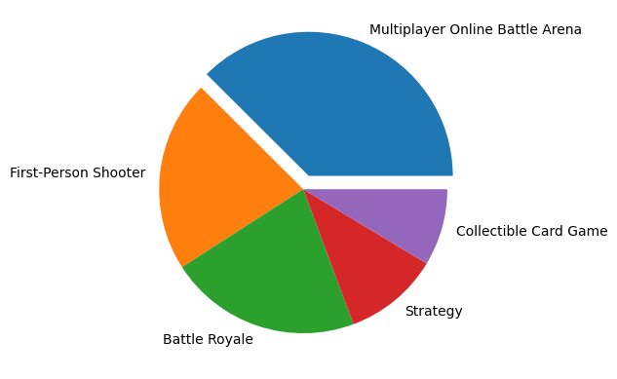
Popularity:
Find out which video game genre is the most accounted for the most.
(Rounded %’s: MPOBA-40%, 1st Person Shooter-20% Battle Royale-20% Strategy-10% Collectible Card Game-10%)
Note: this data is based on two different datasets and remain consistent

Slide 21
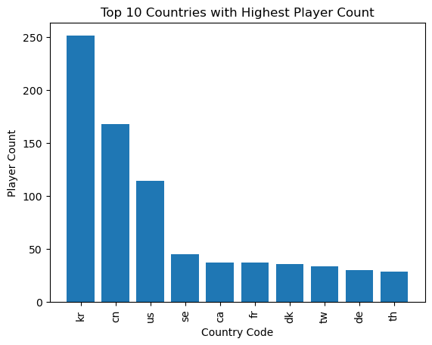
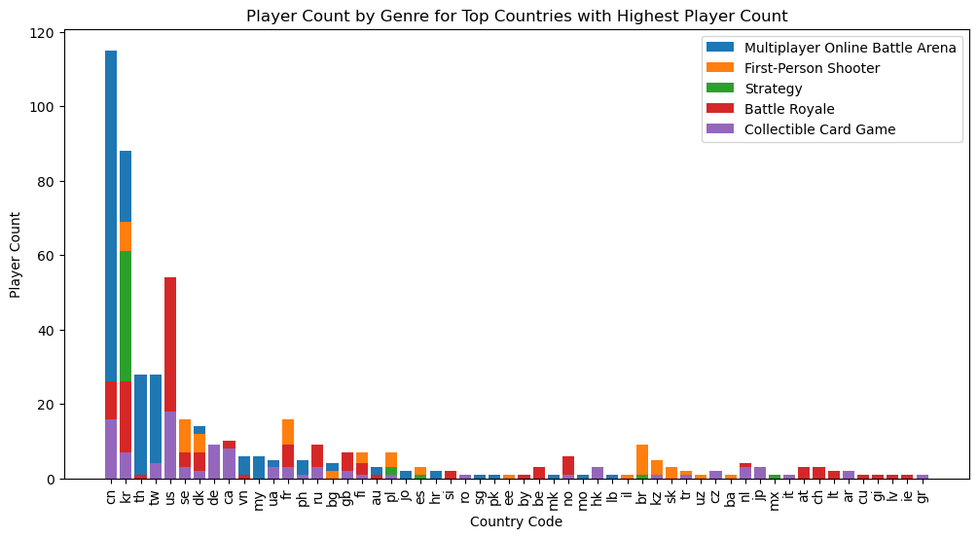
Popularity by Country
Top 10 countries based on player count
Allows us to gain insight on where the highest concentration of player are based on Country
Based on the graph to the right it looks as if “Multiplayer Online Battle Arena” is the most popular genre played in 5 of the Top 10 Countries w/ the highest player count.

Slide 22
Top 10 Countries:
Korea(KR), China(CN), United States (US), Sweden(SE), Canada(CA), France(FR), Denmark(DK), Taiwan(TW), Germany(DE), Thailand(TH)

Slide 23
III. Popularity
Now that we were able to identify the most popular genre in regards to popularity now lets see which genre has the best earnings

Slide 24
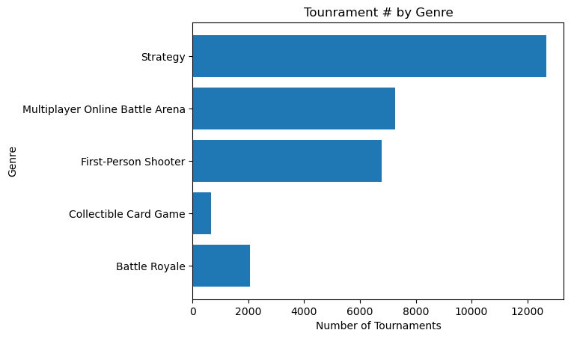
Per the Bar Graph above it looks as if the Genre with the Highest Earning Potential based on the amount of Tournaments is held is “Strategy”
In the next slide let’s try to confirm this by looking at the actual earnings

Slide 25
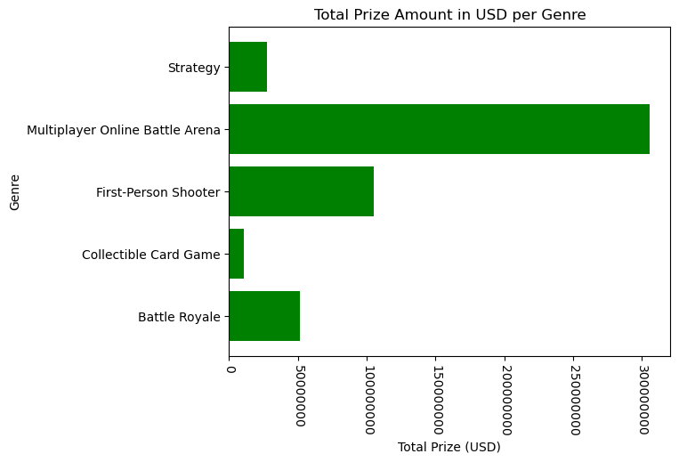
We can see now that “Strategy” might have the highest earning potential based on Genre but in all actuality “Multiplayer Online battle Arena” is by far the best Genre in terms of earnings

Slide 26
III. Popularity
So with Multiplayer Online Battle Arena seeming to be the most popular genre let’s find out if the most popular game is under the same genre

Slide 27
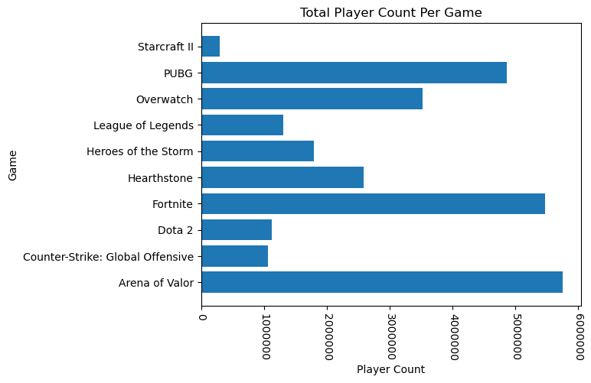
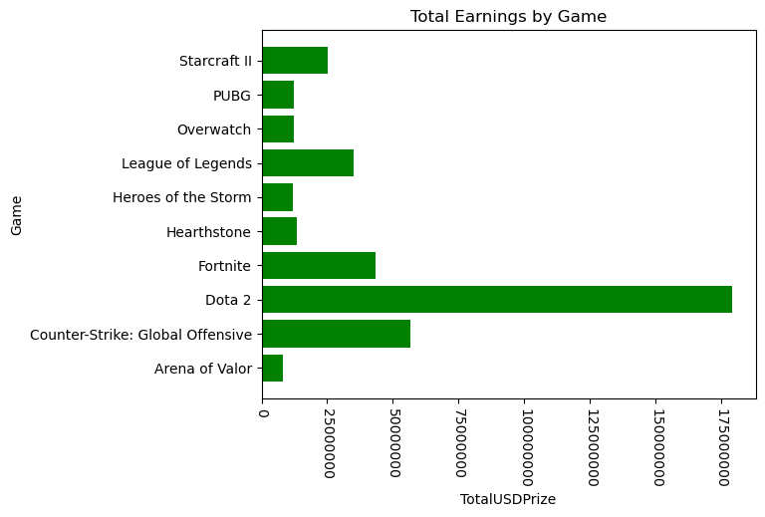
Popularity by Game
Per the graph on the left it looks as if the top 5 most played games are Arena of Valor, Fortnite, PUBG, Overwatch & Hearthstone.
In terms of most profitable, it looks as if Dota 2 is the best game to profit from followed by Counter Strike then Fortnite.

Slide 28
04
Viewership
Questions 2: If one were to pursue competitive gaming as a career what game should they play? What is the best way to generate income? (Bryan Miller)

Slide 29
IV. Viewership
The two data sets I will be using are the twitch streaming information (2016-2023) and TTl Prize money by player and game(2022)

Slide 30
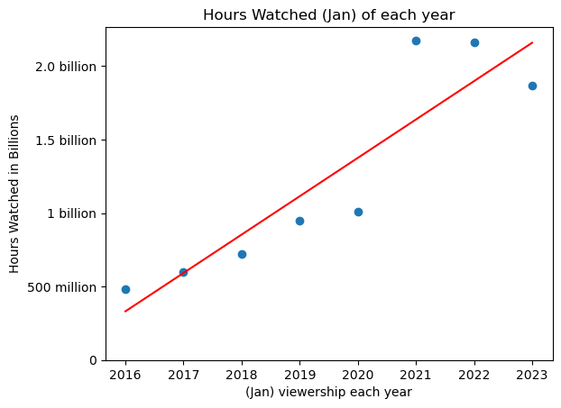
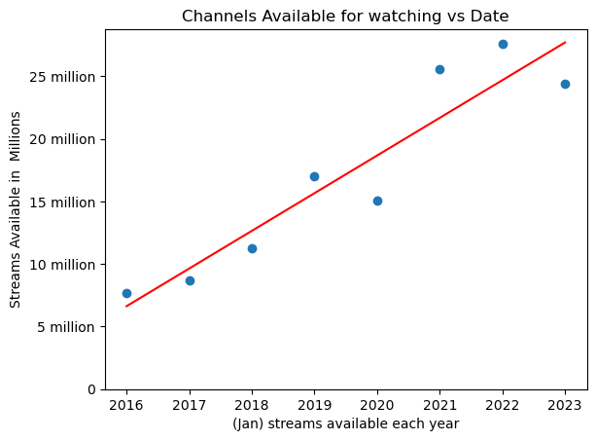
The graphs above show that Twitch has experienced considerable growth. Both “Hours Watched” and “Channels Available” have skyrocketed over the past 7 years.

Slide 31
IV. Viewership
Let’s see how viewership changes over a 5 year period by Game.
Top 10 Games

Slide 32
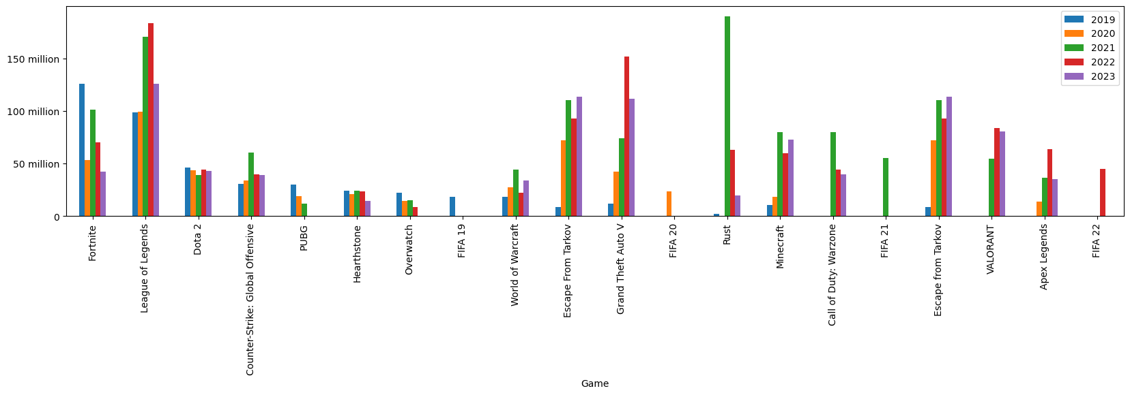
We can see that League of Legends, GTA V, and Fortnite consistently receive high viewership. Surprisingly, Dota 2 (top prize money) isn’t as popular.

Slide 33
IV. Viewership & Prize Pools
Now, let’s cross reference twitch highest viewership games with the games with the largest prize pools. (12/2022)

Slide 34
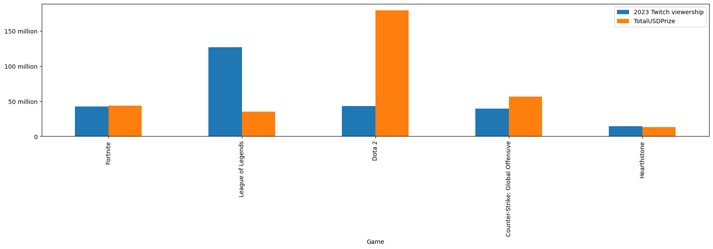
This gives us the best games to play to have the highest odds of generating money. 12/2022

Slide 35
05
eSports v. Traditional Sports

Slide 36



Slide 37
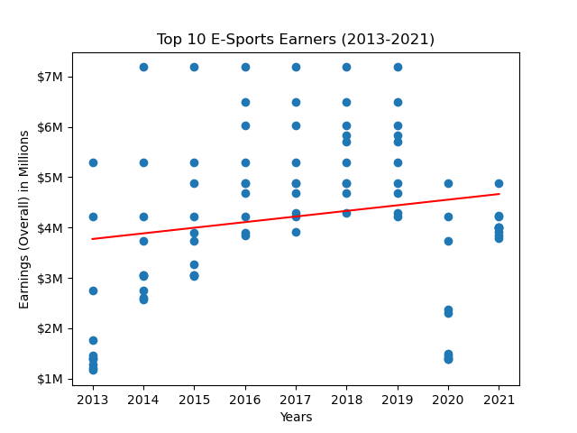
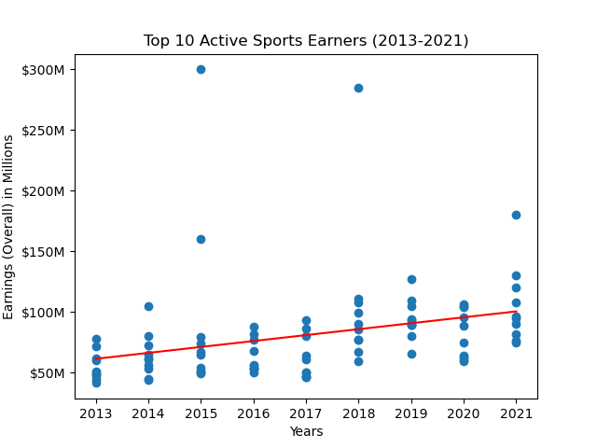

Slope 111,490
The positive slope suggests a slight increase in earnings over time, although the p-value (0.091) indicates that the relationship is not statistically significant.
Slope 4,891,333
The positive slope indicates a increase in earnings over time, supported by the low p-value (0.003).

Slide 38
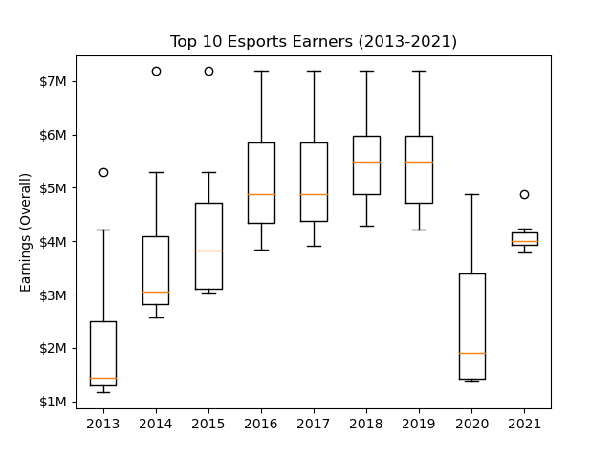
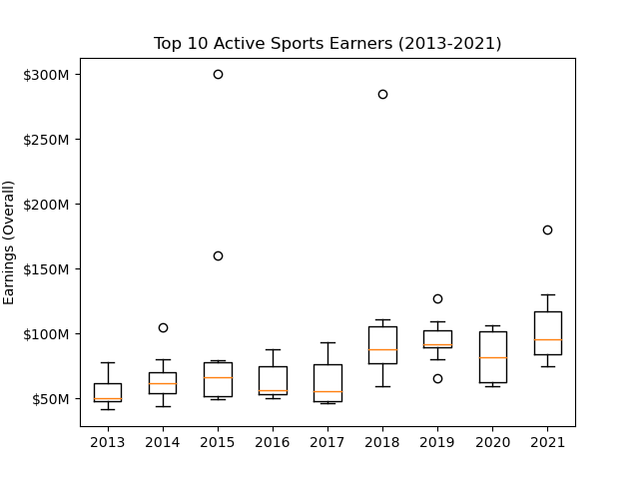
Both having earners that outperform or underperform from a financial standpoint(outliers).

Slide 39
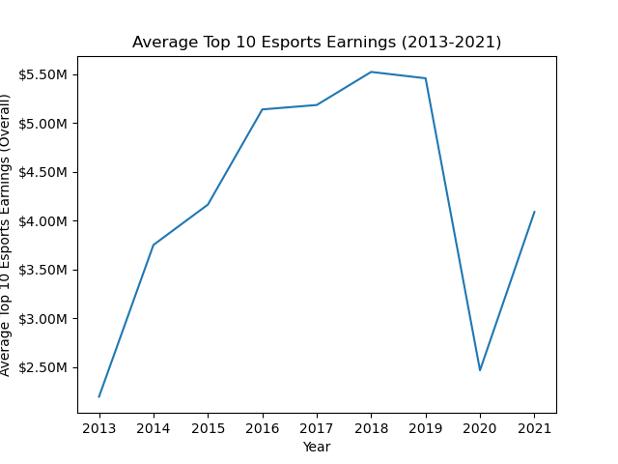
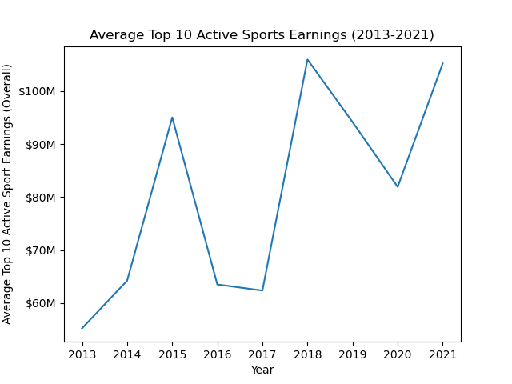
Average earnings for the top 10 esports and active sports earners for years 2013-2021 .

Slide 40
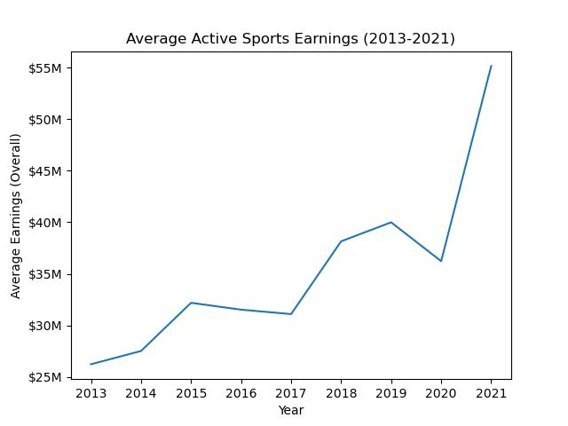
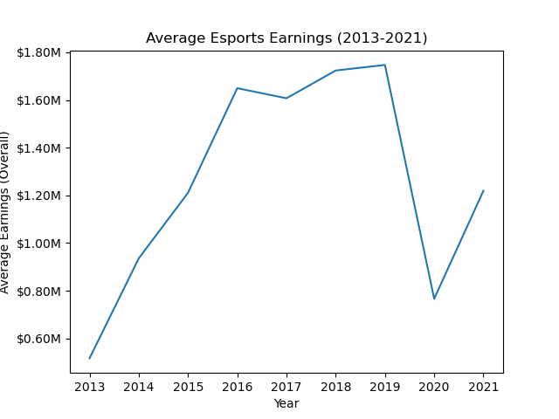
Average earnings for the esports and active sports earners for years 2013-2021 .

Slide 41
Top 10 Esports/Active Sports Earners T-Test
T-Statistic: -17.67153631041991
P-Value: 5.132170911238922e-41
Based on the t-statistic and the very small p-value, we can infer that there is a statistically significant difference in earnings between the top 10 esports earners and the top 10 active sports earners. The negative t-statistic suggests that the average earnings of the top 10 esports earners are lower than the average earnings of the top 10 active sports earners. The extremely small p-value indicates strong evidence against the null hypothesis of equal average earnings between the two groups.

Slide 42

Conclusion…
His best odds are:
Going pro in a traditional sport
OR
Playing a MOBA (Dota2 for tournament earnings or LOL for twitch + tournaments)
Moving to Korea

Slide 43
THANKS
Does anyone have any questions?

